Slide 1

PRACTICAL SUBMISSION STATISTICAL MODELS FOR MACHINE LEARNING ALGORITHMS
Presented By: Amit Sharma
[Bsc Data Science]
Presented To: Mrs. Dr. Aashima Bangia,
[Assistant professor],
AAFT (SODS)
AAFT | SODS | 2024

Slide 2
topics
1. matrices & vector
2. introduction to ml
3. supervised learning
4. model evaluation
5. unsupervised learning
6. ml projects

Slide 3

1. matrices & vector

Slide 4
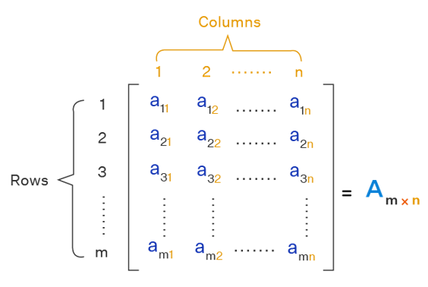
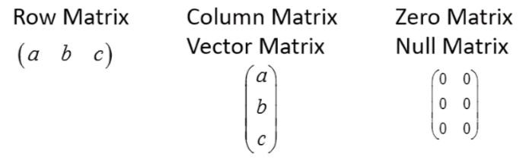
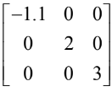
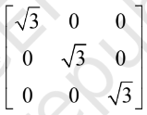
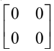
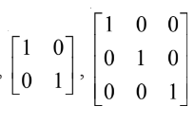
MATRIX (MATRICES)
When we say our data in rectangular form then the data called matrix.
TYPES OF MATRIX
1. square matrix 2. rectangular matrix
1. Diagonal matrix
2. Scalar matrix
3. Zero matrix
6. Unit matrix
5.Identity matrix

Slide 5
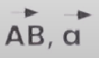
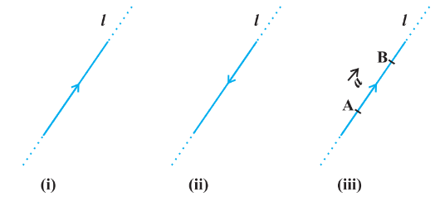
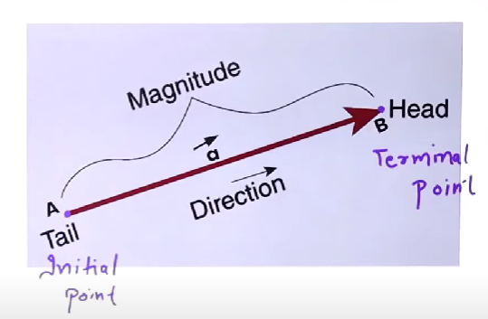
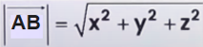
vector
Directed line segment is called VECTOR.
Denoted by
rEPRESENTATION OF VECTOR
MAGNITUDE

Slide 6

2. introduction to ml

Slide 7
TYPES OF VECTOR
Zero Vector: A vector with all components equal to zero. It has no direction and its magnitude is zero.
Unit Vector: A vector with a magnitude of one. It is often used to indicate direction.
Position Vector: A vector that represents the position of a point in space relative to an origin.
Co-initial Vectors: Vectors that have the same initial point.
Collinear Vectors: Vectors that lie along the same line or parallel lines, regardless of their magnitudes.
Equal Vectors: Vectors that have the same magnitude and direction.
Negative Vectors: Vectors that have the same magnitude as a given vector but opposite direction.
Parallel Vectors: Vectors that are parallel to each other and may have different magnitudes.
Orthogonal Vectors: Vectors that are perpendicular to each other.
Coplanar Vectors: Vectors that lie in the same plane.

Slide 8
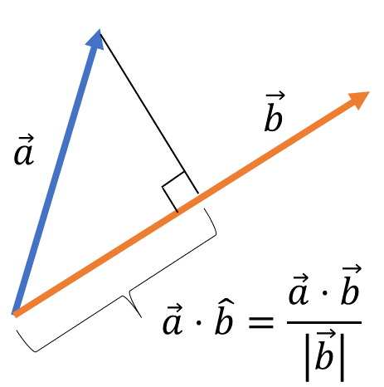
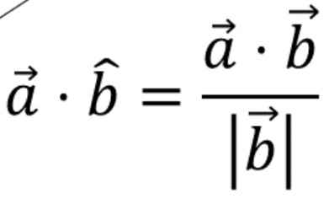
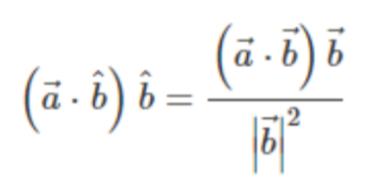
PROJECTION OF VECTOR
In Resolution of vectors we resolve vectors in two dimensions along horizontal and vertical axes. It is also possible to resolve one vector along the line of another vector (instead of along the x-y axes).
THERE ARE 2 TYPES OF VECTOR PROJECTION:
1. Scalar projection 2. Vector projection

Slide 9
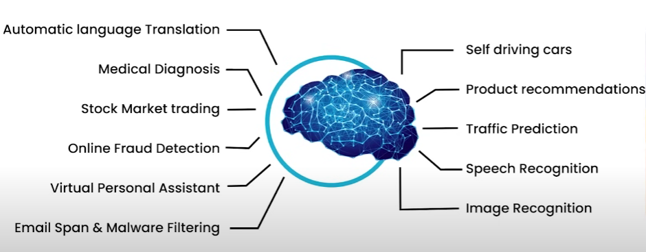
MACHINE LEARNING
Machine learning is a subset of artificial intelligence (AI) that focuses on the development of algorithms and statistical models that enable computers to perform tasks without being explicitly programmed for those tasks.

Slide 10
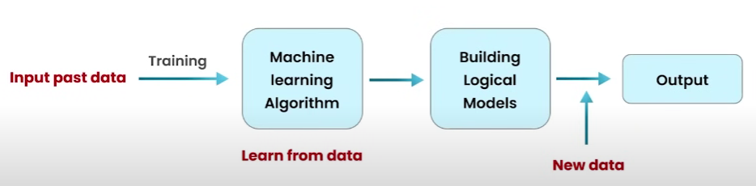
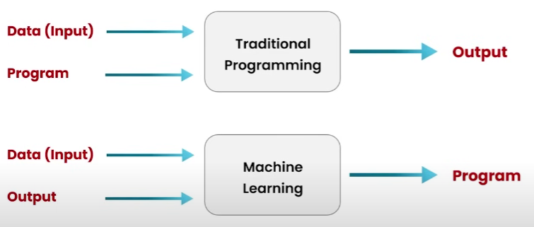
how does machine learning work
A Machine Learning system learns from historical data., builds the prediction models, and whenever it receives new data, predicts the output for it.

Slide 11
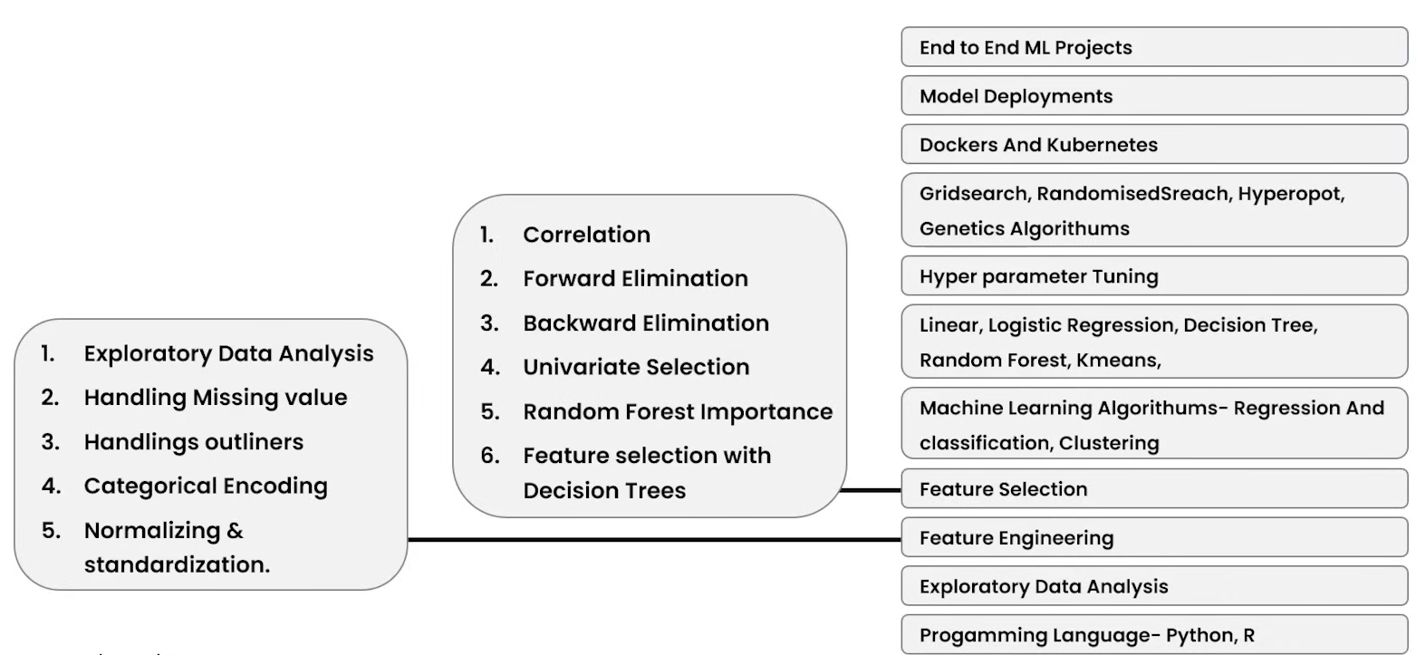
rOADMAP TO LEARN MACHINE LEARNING

Slide 12
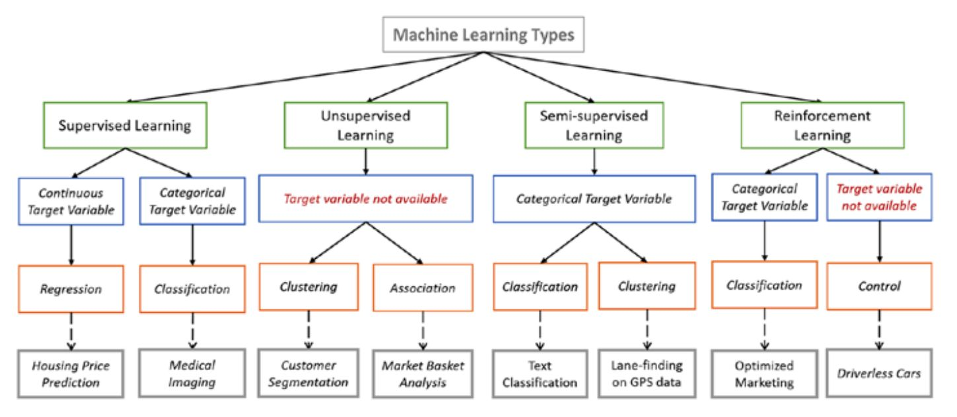
tYPES OF MACHINE LEARNING

Slide 13
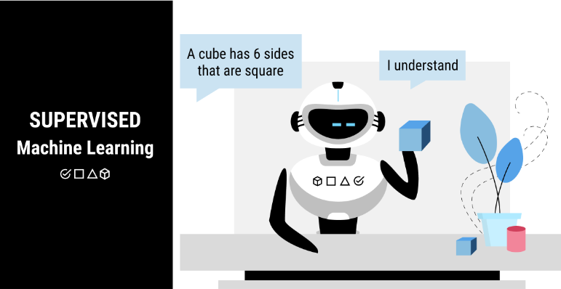
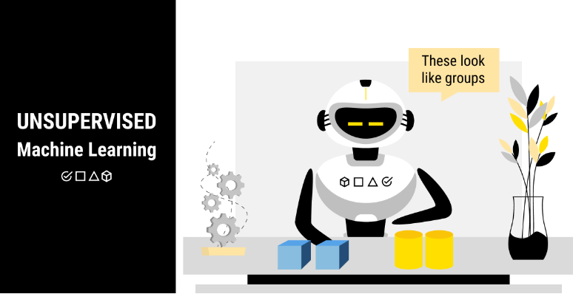
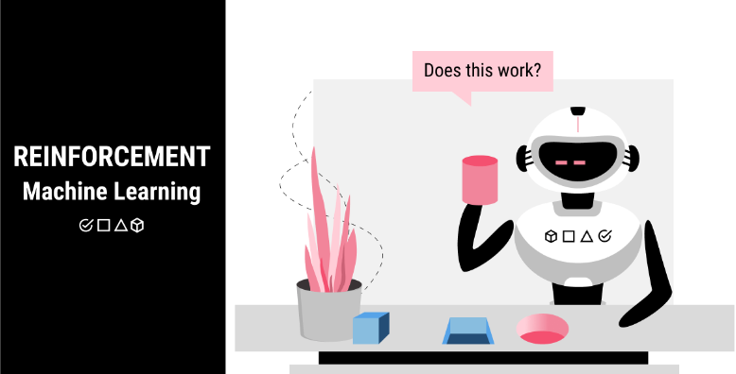

Slide 14
3. supervised learning

Slide 15
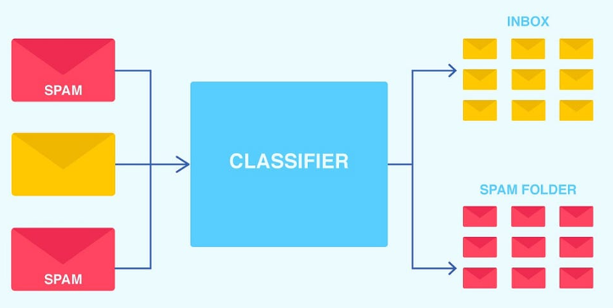
SUPERVISED MACHINE LEARNING
Definition: In supervised learning, the algorithm learns from labeled data, with each example being a pair consisting of an input and a desired output. It learns a mapping function
from input to output.
Example: It classify emails as "spam" or "not spam" by using features like keywords and sender info from a labeled dataset.
types:
1. Classification: When the output variable is a category & decrete, such as "spam" or "not spam".
2. Regression: When the output variable is a continuous value, such as predicting house prices.

Slide 16
Types of Regression Algorithms
Linear Regression: Models the relationship between a dependent variable and one or more
independent variables with a straight line.
equation: y = mx + x
2. Polynomial Regression: Extends linear regression by fitting a polynomial curve to the data.
3. Ridge Regression: Linear regression with L2 regularization to prevent overfitting.
4. Lasso Regression: Linear regression with L1 regularization to perform feature selection.
5. Elastic Net: Combines L1 and L2 regularization for linear regression.
6. Support Vector Machine (SVM): Can perform both classification and regression. In classification (SVC), it finds the optimal hyperplane to separate classes. In regression (SVR), it finds the best-fit line within a specified margin.
7. Decision Tree: Can be used for both classification and regression. In classification, it splits data into classes based on feature values. In regression, it predicts continuous values by splitting data into subsets based on feature values.

Slide 17
Classification Algorithms
Decision Trees: Models decisions with tree-like structures.
Logistic Regression: Predicts binary outcomes.
SVM: Separates classes with a hyperplane.
Naive Bayes: Uses probability based on feature independence.
KNN: Classifies based on nearest neighbors.
Random Forest: Ensemble of decision trees.
Gradient Boosting Machines (GBM): Sequentially improves weak models.
Neural Networks: Layers of nodes learning patterns.

Slide 18
difference between
supervised ml
unsupervised ml
Data is labeled.
Algorithm learns from labeled data.
Predictions based on learned patterns.
Examples: classification, regression.
Data is unlabeled.
Algorithm discovers patterns on its own.
No predefined outputs.
Examples: clustering, dimensionality reduction.

Slide 19
4. model evaluation

Slide 20
Model Evaluation:
Important component in Data Science lifecycle which occurs post Model Training.
Assess performance of a model on a dataset.
Determine how well the model is generalize to unseen data.
To select best performing model.
1. Classification:
• Accuracy
• Precision (Positive prediction Value)
• Recall (True Positive Rate or Sensitivity)
• F1-Score
• Confusion Matrix
• AUC-ROC
Model Evaluation Metrics:
2. Regression:
• Mean Squared Error
• Root Mean Squared Error
• Mean Absolute Error
• R-Squared Score (R2)
• Adjusted R-Squared Score
3. Clustering:
• Silhouette Coefficient

Slide 21
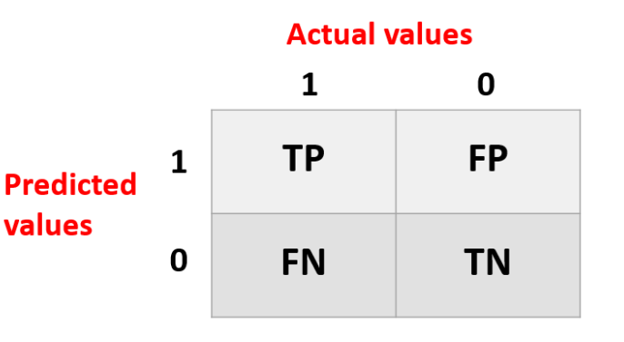
confusion matrix
A confusion matrix is a simple and usefule tool for understanding the performance of a classification model, like one used in machine learning or statistics.
It helps you evaluate how well your model is doing in categorizing things correctly.
It is also known as the error matrix.
The matrix consists of predictions result in a summarized form, which has the number of correct predictions and incorrect predictions.

Slide 22
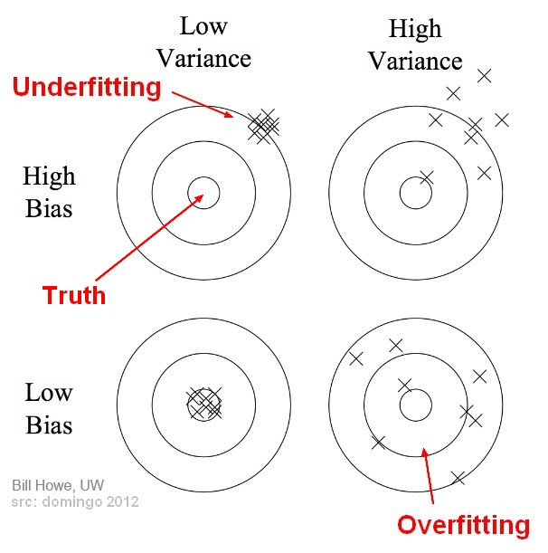
Bias: Error from simplifying the model too much (underfitting).
Variance: Error from making the model too complex (overfitting).
Overfitting: Model learns noise, not just the pattern (too complex).
Underfitting: Model fails to learn the pattern (too simple).
In summary:
High bias → Underfitting → Simple model.
High variance → Overfitting → Complex model.
Good models balance bias and variance to perform well on new data.

Slide 23
5. unsupervised learning

Slide 24
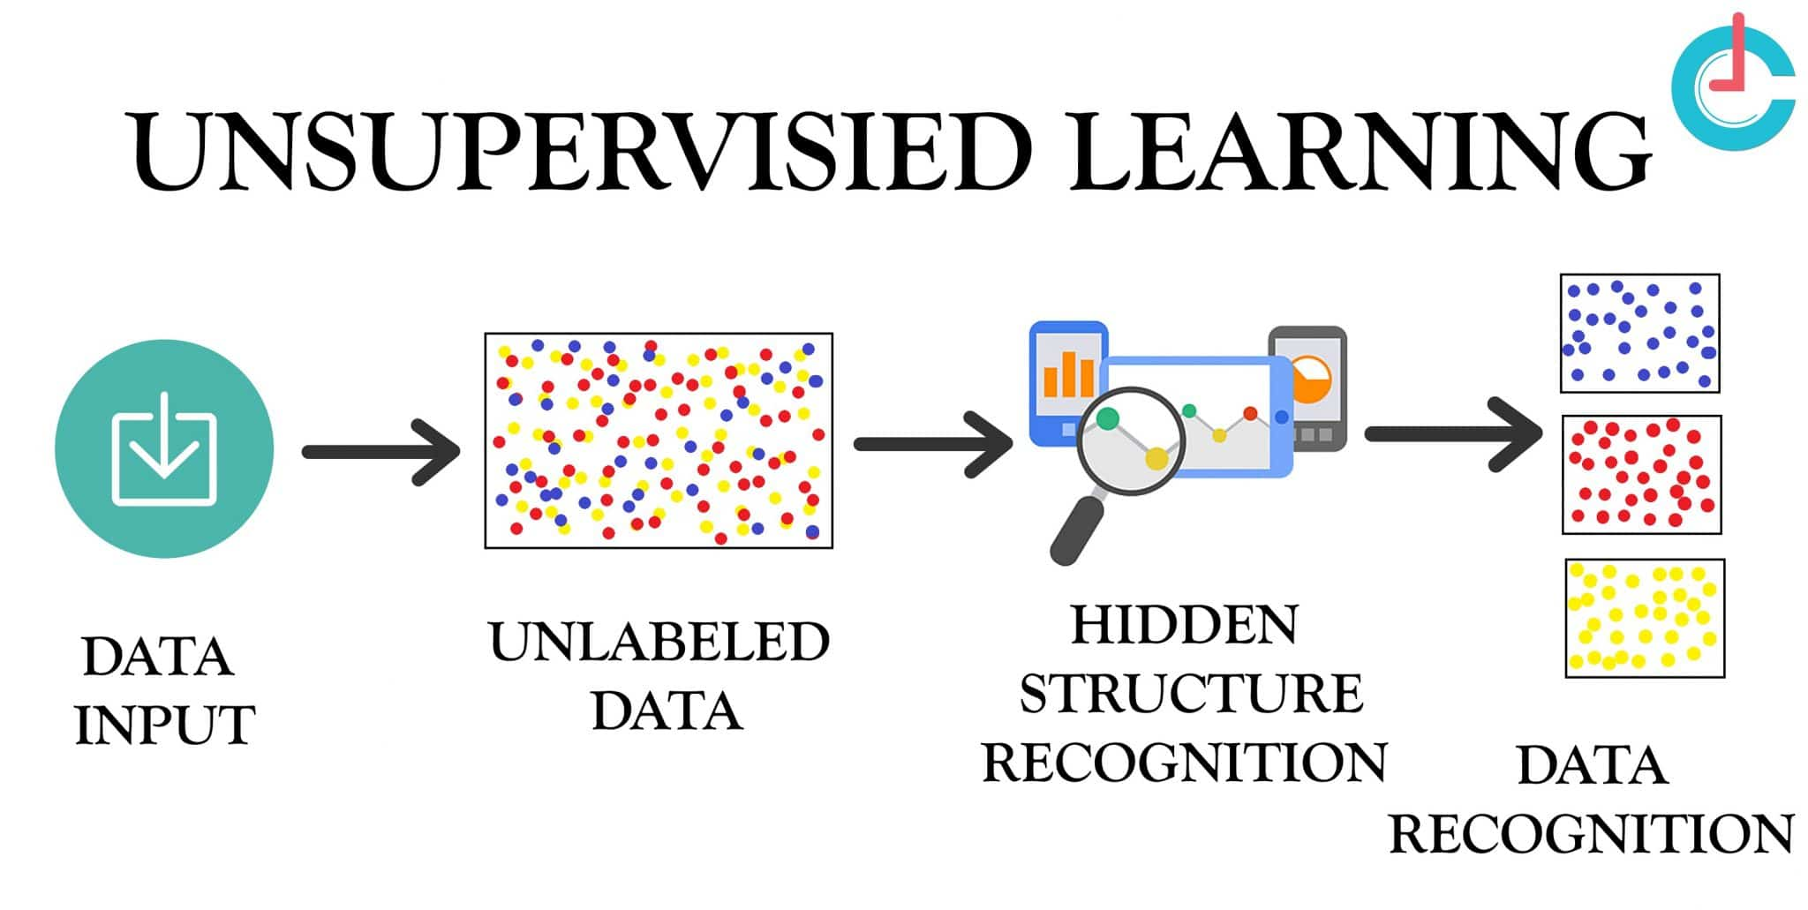
Unsupervised Learning
Unsupervised learning deals with data that has no labeled responses.
The system tries to learn the patterns and structure from the data on its own.

Slide 25
types of unsupervised learning
1. Clustering: In clustering, the algorithm organizes data into groups or clusters based on similarities among the data points. Common algorithms include K-Means, Hierarchical Clustering, DBSCAN, and Gaussian Mixture Models.
2. Dimensionality Reduction: Dimensionality reduction techniques aim to reduce the number of features in a dataset while preserving important information. This is often done to simplify data analysis and visualization. Principal Component Analysis (PCA), t-SNE, and Autoencoders are examples of dimensionality reduction techniques.
3. Association Rule Learning: Association rule learning focuses on finding interesting relationships or associations among variables in large datasets. The Apriori algorithm is a popular example used for mining association rules in transactional databases.
These three types encompass a wide range of algorithms and techniques used in unsupervised learning tasks.

Slide 26


projects

Slide 27
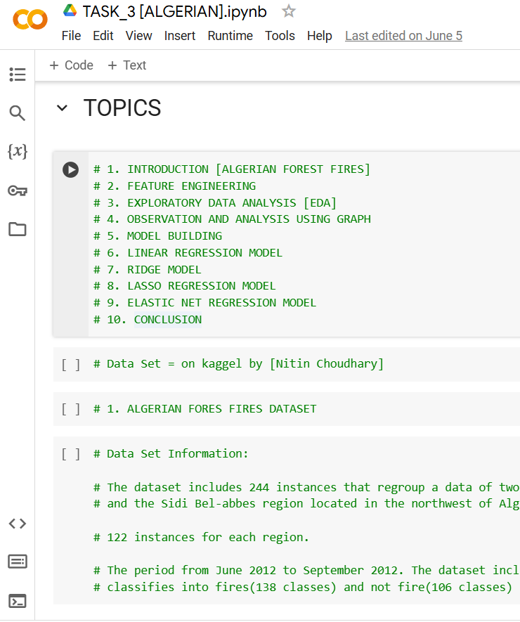
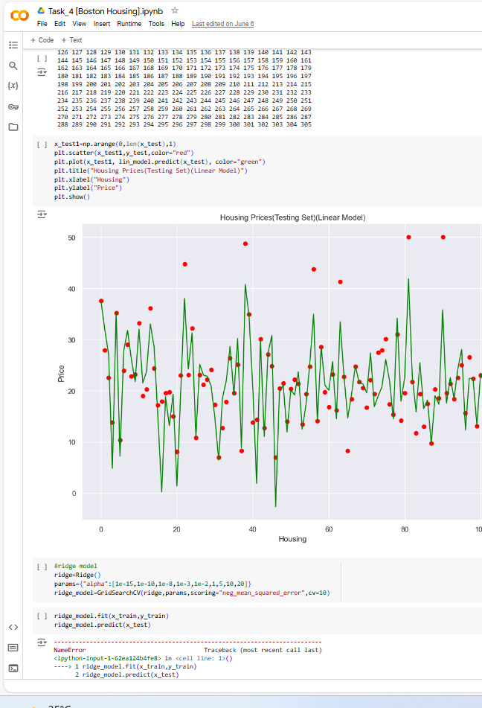
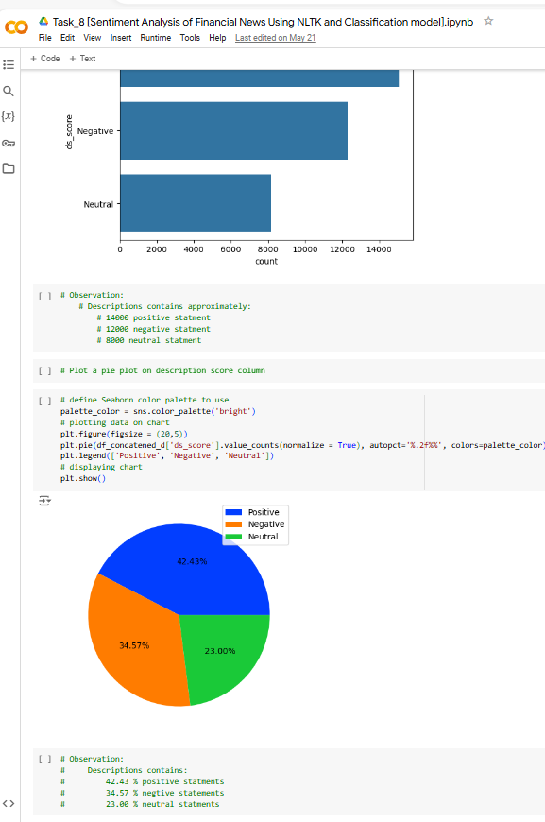
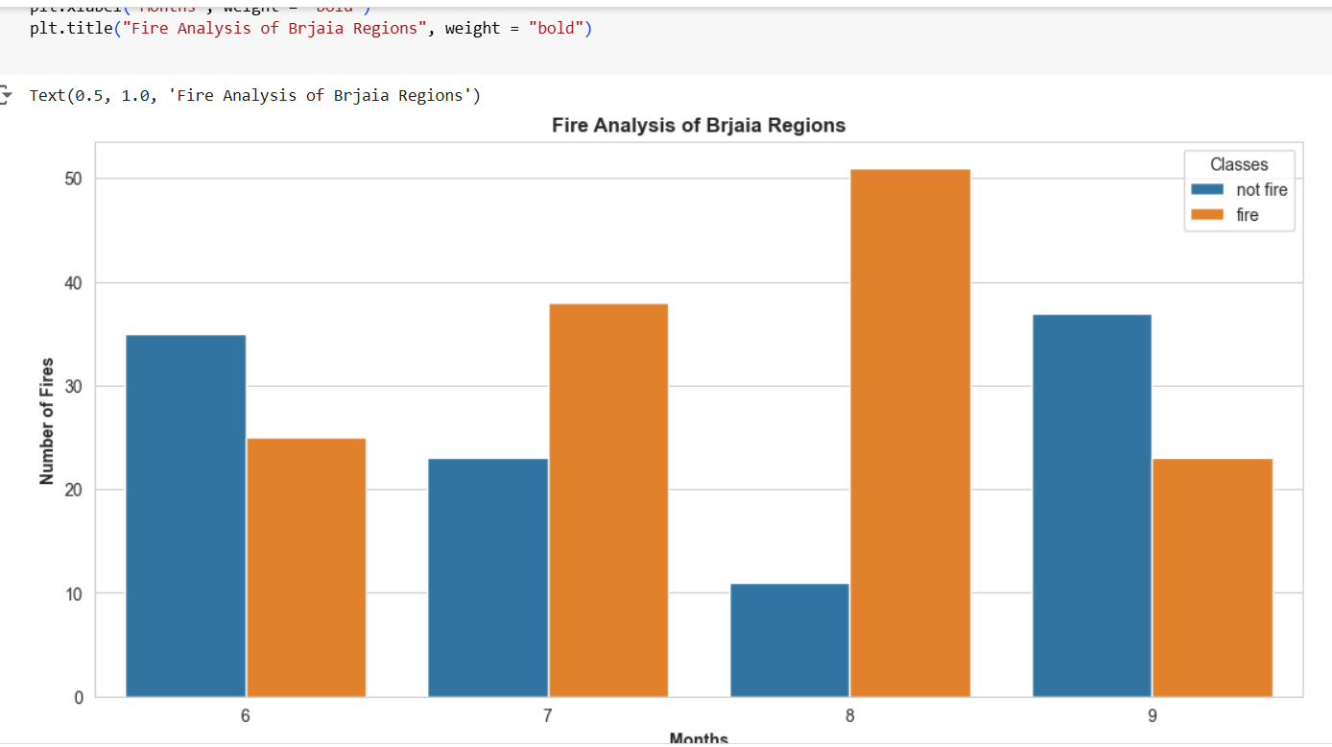
algerian boston sentimental analysis

Slide 28


Thank you
https://github.com/Amit123456777
https://www.linkedin.com/in/amit-sharma-868b3a23a/
amsharma2607@gmail.com

